Slide 1
ECEG-5193: Algorithm Analysis and Design
Algorithm Design Techniques
Divide and Conquer

Slide 2
Divide and Conquer
Algorithm design paradigm that follows the following steps
Breaks up a problem into independent sub problems.
Solve each problem.
Combine results of the sub problems to form a solution to the original problem.
Notes:
Precedes succeeds

Slide 3
Divide-and-Conquer Algorithms
A divide-and-conquer algorithm is one that works as follows:
(Divide)
Split the input apart into multiple smaller pieces, then recursively invoke the algorithm on those pieces.
(Conquer)
Combine those solutions back together to form the overall answer.
Can be analyzed using recurrence relations.

Slide 4
Finding the Maximum Value
3 | 1 | 4 | 10 | 5 | 9 | 12 | 6 | 7 | 8 | 11 | 2 | 13 | 14 | 0 | 11
11

Slide 5
Finding the Maximum Value
3
10
9
12
8
11
14
11
14
3 | 1 | 4 | 10 | 5 | 9 | 12 | 6 | 7 | 8 | 11 | 2 | 13 | 14 | 0 | 11
11

Slide 6
Finding the Maximum Value
3 | 10 | 9 | 12 | 8 | 11 | 14 | 11
3 | 1 | 4 | 10 | 5 | 9 | 12 | 6 | 7 | 8 | 11 | 2 | 13 | 14 | 0 | 11
11

Slide 7
Finding the Maximum Value
10
12
11
14
3 | 10 | 9 | 12 | 8 | 11 | 14 | 11
3 | 1 | 4 | 10 | 5 | 9 | 12 | 6 | 7 | 8 | 11 | 2 | 13 | 14 | 0 | 11
11

Slide 8
Finding the Maximum Value
10 | 12 | 11 | 14
3 | 10 | 9 | 12 | 8 | 11 | 14 | 11
3 | 1 | 4 | 10 | 5 | 9 | 12 | 6 | 7 | 8 | 11 | 2 | 13 | 14 | 0 | 11
11

Slide 9
Finding the Maximum Value
12
14
10 | 12 | 11 | 14
3 | 10 | 9 | 12 | 8 | 11 | 14 | 11
3 | 1 | 4 | 10 | 5 | 9 | 12 | 6 | 7 | 8 | 11 | 2 | 13 | 14 | 0 | 11
11

Slide 10
Finding the Maximum Value
12
14
10 | 12 | 11 | 14
3 | 10 | 9 | 12 | 8 | 11 | 14 | 11
3 | 1 | 4 | 10 | 5 | 9 | 12 | 6 | 7 | 8 | 11 | 2 | 13 | 14 | 0 | 11
11

Slide 11
Finding the Maximum Value
14
12
14
10 | 12 | 11 | 14
3 | 10 | 9 | 12 | 8 | 11 | 14 | 11
3 | 1 | 4 | 10 | 5 | 9 | 12 | 6 | 7 | 8 | 11 | 2 | 13 | 14 | 0 | 11
11

Slide 12
Finding the Maximum Value
14
12
14
10 | 12 | 11 | 14
3 | 10 | 9 | 12 | 8 | 11 | 14 | 11
3 | 1 | 4 | 10 | 5 | 9 | 12 | 6 | 7 | 8 | 11 | 2 | 13 | 14 | 0 | 11
11

Slide 13
Finding the Maximum Value
14
12
14
10 | 12 | 11 | 14
3 | 10 | 9 | 12 | 8 | 11 | 14 | 11
3 | 1 | 4 | 10 | 5 | 9 | 12 | 6 | 7 | 8 | 11 | 2 | 13 | 14 | 0 | 11
11
T(1) = Θ(1)
T(n) = T(⌈n / 2⌉) + Θ(n)
Θ(n)

Slide 14
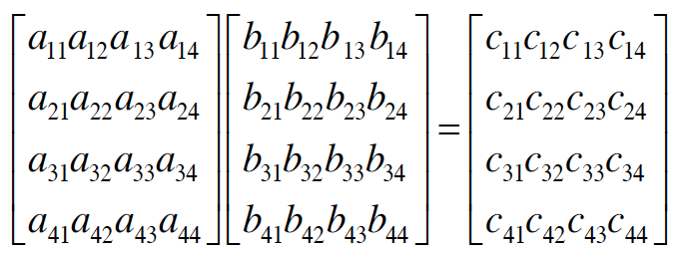
MATRIX MULTIPLICATION

Slide 15
Multiplying Matrices
N³ MULTIPLICATIONS, N³-N² ADDITIONS

Slide 16
Simple Matrix Multiply
for i = 1 to n
for j = I to n
C[i,j] = 0
for k = 1 to n
C[i,j] = C[i,j] + A[i,k] * B[k,j]
N³ MULTIPLICATIONS, N³-N² ADDITIONS

Slide 17
Multiplying Matrices

Slide 18
Multiplying Matrices
A₁₁
A₁₂
B₁₁
B₁₂
A₂₁
A₂₂
B₂₁
B₂₂
A₁₁B₁₁+A₁₂B₂₁
A₁₁B₁₂+A₁₂B₂₂
A₂₁B₁₁+A₂₂B₂₁
A₂₁B₁₂+A₂₂B₂₂

Slide 19
MATRIX MULTIPLICATION
Divide and conquer?
• Break into 4 pieces

Slide 20
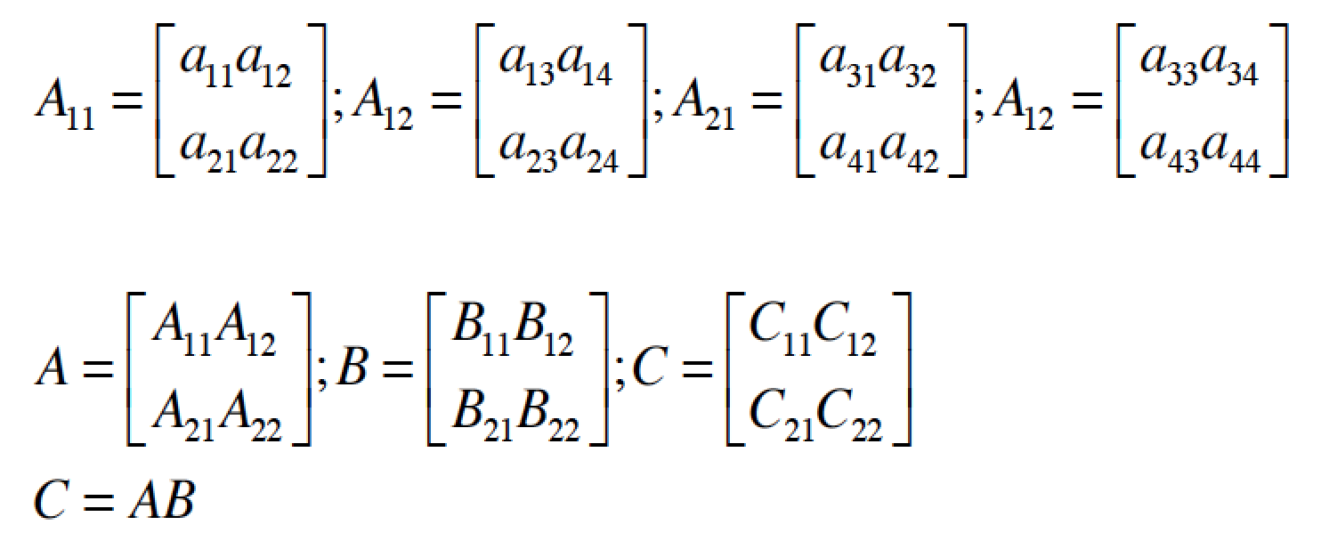
MATRIX MULTIPLICATION

Slide 21
MATRIX MULTIPLICATION
How many recursive calls to matrix multiply?
8 total multiplications = 8 recursive calls
Cost of combining recursions?
4 matrix additions, each matrix size n²/4

Slide 22
Multiplying Matrices
A₁₁
A₁₂
B₁₁
B₁₂
A₂₁
A₂₂
B₂₁
B₂₂
A₁₁B₁₁+A₁₂B₂₁
A₁₁B₁₂+A₁₂B₂₂
=
A₂₁B₁₁+A₂₂B₂₁
A₂₁B₁₂+A₂₂B₂₂
Counting arithmetic operations:
T(n) = 8T(n/2) + 4(n/2)² = 8T(n/2) + n²

Slide 23
MATRIX MULTIPLICATION
Divide: constant time
Conquer: 8 matrix multiplications of size
Combine: 4 matrix additions, each has size
Total:
Cost?

Slide 24
Multiplying Matrices
1 if n = 1
T(n) =
8T(n/2) + n² if n > 1
By Master Recurrence, if T(n) = aT(n/b)+cn^{k} & a > b^{k} then T(n) =

Slide 25
Strassen’s method for matrix multiplication
A divide and conquer approach
Divide each nxn matrix into four matrices of size (n/2)x(n/2):
Computing all of requires 8 multiplications and 4 additions.
Therefore, the total running time is
Using the Master Theorem, this solves to . Still cubic!
Can we do better with a straightforward divide and conquer approach?
Notes:
[] לפני שנציג את השיטה ננסה לראות מה קורה כשממנים להחיל את עיקרון "הפרד ומשול" באופן נאיבי:
[] כדי לכפול זוג מטריצות A וְ – B בגודל n, נחלק כל אחת מן המטריצות לארבע מטריצות בגודל n/2.
[] נבחין כי במטריצת התוצאה, כל רבע ממנה מחושב על ידי מכפלת זוג רבעים של המטריצות המקוריות.
[] חישוב של כל רבע במטריצת התוצאה דורש שתי פעולות מכפלה של מטריצות קטנות יותר ופעולת חיבור.
[] בסה"כ נדרשות 8 פעולות כפל וארבע פעולות חיבור. לכן, זמן הריצה יכול להיות מחושב לפי נוסחת נסיגה.
[] על ידי שימוש במשפט המאסטר, אפשר למצוא כי מהנוסחה נובע שזמן הריצה נשאר באותו סדר גודל
כפי שהיה אם היינו מבצעים את המכפלה באופן נאיבי.
[] האם ניתן לחשוב על שיטה טובה יותר המבוססת על עיקרון "הפרד ומשול"?
25

Slide 26
Strassen’s method for matrix multiplication
Strassen’s algorithm
Define seven matrices of size (n/2)x(n/2) :
The four (n/2)x(n/2) matrices can be defined in terms of M₁,…,M₇:
26
Notes:
[] המהות של השיטה של Srassen: הפחתה במכפלה אחת של מטריצות על חשבון מספר פעולות חיבור וחיסור נוספות.
[] מכפלת המטריצות הקטנות יותר הנובעות מחלוקה המטריצות המקוריות לארבעה רבעים, מחושבת באופן רקורסיבי.
[] בסה"כ בכל שלב יש לנו 7 פעולות מכפלה והרבה פעולות חיבור וחיבור שדורשות זמן בסדר גודל של O(n²).
הערה: השיטה של Strassen כוללת פעולות חיבור, כפל וחיסור של מטריצות. פעולות לוגיות המתאימות לחיבור ולכפל הן
OR וְ-AND, אבל חסרה פעולה לוגית מתאימה עבור חיסור. לכן, כדי להתאים את השיטה לכפל מטריצות בוליאניות, תוצאה
חיובית של מכפלת שורה בעמודה נמיר לערך 1 ותוצאה שהיא 0 נשאיר כמו שהיא. לדוגמא:
[1 0 1] * [1 1 1] = 1*1 + 0*1 + 1*1 = 2 >> 1
26

Slide 27
Strassen’s method for matrix multiplication
Strassen’s algorithm
Running time? Each matrix Mi requires additions
and subtractions but only one multiplication:
which solves to
O(n^{2.807}) | Volker Strassen: Strassen’s method , First sub-cubic time algorithm | 1969
27
27
Notes:
[] הפעלה רקורסיבית של השיטה של Strassen בכל מכפלה המתבקשת עבור M_{i} תיתן את זמן הריצה המתואר.
[] השיטה של Strassen הוצעה על ידי Volker Strassen בשנת 1969, בערך באותו הזמן בו הוצעה השיטה
של ארבעת הרוסים.
http://www.cs.berkeley.edu/~virgi/matrixmult.pdf
http://en.wikipedia.org/wiki/Matrix_multiplication
http://en.wikipedia.org/wiki/Coppersmith%E2%80%93Winograd_algorithm
27

Slide 28
Strassen’s method for matrix multiplication
Improvements
O(n^{2.796}) | V. Y. Pan. Strassen’s algorithm is not optimal. | 1978
O(n^{2.7799}) | D. Bini et al. O(n^{2.7799}) complexity for nxn approximate matrix multiplication. | 1979
O(n^{2.522}) | A. Schönhage. Partial and total matrix multiplication. | 1981
First to break the 2.5 barrier:
O(n^{2.496}) | CopperSmith and Winograd On the asymptotic complexity of matrix multiplication. | 1981
O(n^{2.479}) | Volker Strassen | 1986
O(n^{2.376}) | CopperSmith and Winograd Matrix multiplication via arithmetic progressions. | 1989
O(n^{2.3727}) | Virginia Vassilevska Williams: Breaking the Coppersmith-Winograd barrier | 2011
28
28
Notes:
[] קופרסמית' ווינוגרד לא נשארו חייבים והראו לשטראסן כי טובים השניים מן האחד.
[] במשך למעלה מעשרים שנים השיא לא נשבר, עד אשר לאחרונה חוקרת בשם וירג'יניה
וסילבסקה וויליאמס, מאוניברסיטת ברקלי (קליפורניה) מצאה את החסם הטוב ביותר עד כה.
28

Slide 29
Best choices for matrix multiplication
Using the exact formulas for time complexity, for square matrices, crossover points
have been found:
For n<7, the naïve algorithm for matrix multiplication is preferred. As an example, a 6x6 matrix requires 482 steps for the method of 4- Russians, but 468 steps for the naïve multiplication.
For 6<n<513, the method of 4-Russians is most efficient.
For 512<n, Strassen’s approach costs the least number of steps.
29
Notes:
[] תוך שימוש בנוסחאות המדויקות לסיבוכיות זמן הריצה של השיטות השונות, ניתן להבחין בערכים
עבורם עדיפה שיטה אחת על פני האחרת.
[] לדוגמא, עבור n<7...
[] נסייג ונאמר כי החישובים כאן נלקחו ממאמר שהציג וריאציה של השיטה של ארבעת הרוסים והיא
אינה זהה לשיטה כפי שתיאר לי פרופ' דיניץ.
[] בנוסף, בשנת 70, חבר של פרופ' דיניץ מסר לו כי לפי חישובים שהוא ערך השיטה של Strassen
למכפלת מטריצות עדיפה על השיטה הנאיבית רק החל ממטריצות שממדיהן בסדר גודל של 10^20.
[] נראה, אם כן, שהנתונים מיוחסים לגישה של Strassen באופן כולל ולאו דווקא לשיטה המקורית.
29

Slide 30
5-2 The Closest Pair Problem
Closest Pair ?
Given a set S of n points, find a pair of points which are closest together
1-D version:
2-D version:
Y
X
Time Complexity：O(nlogn)
X

Slide 31
Closest Pair Algorithm
Input: A set S of n planar points.
Output: The distance between two closest points.
Step 1: Sort points in S according to their y-values.
Step 2: If S contains only one point, return infinity as its distance.
Step 3: Find a median line L perpendicular to the X-axis to divide S into S_{L} and S_{R}, with equal sizes.
Step 4: Recursively apply Steps 2 and 3 to solve the closest pair problems of S_{L} and S_{R}. Let d_{L}(d_{R}) denote the distance between the closest pair in S_{L} (S_{R}). Let d = min(d_{L}, d_{R}).

Slide 32
Closest Pair Algorithm Illustration - 1
Step 1
Step 2
Step 3
If only one point
Time Complexity：O(n)
Y
Y
L
S_{L}
S_{R}
d = ∞
X
X

Slide 33
Closet Pair Algorithm Illustration - 2
Step 4
Time Complexity：2T(n/2)
Y
L
L
S_{L}
S_{R}
X

Slide 34
Closet Pair Algorithm Illustration - 3
Step 5
Y
L
S_{L}
S_{R}
d_{L}
d_{R}
X
L-d
L+d
d=min(d_{L},d_{R})

Slide 35
Closet Pair Algorithm Illustration - 4
Y
P
2d
d
X

Slide 36
Closest Pair Time complexity
Time complexity:
Step 1: O(nlogn)
Step 2~5: T(n) = 2T(n/2)+S(n)+M(n)
Total time-complexity = O(nlogn)+T(n) = O(nlogn)+O(nlogn) = O(nlogn)

Slide 37
Closest pair of points
Question: How to handle the case, where two points can have the same x-coordinate?

Slide 38
The Convex Hull Problem
Convex polygon?
Concave polygon:
Convex polygon :
Maximize area and minimize circumference
Application: Image recognition in robotics

Slide 39
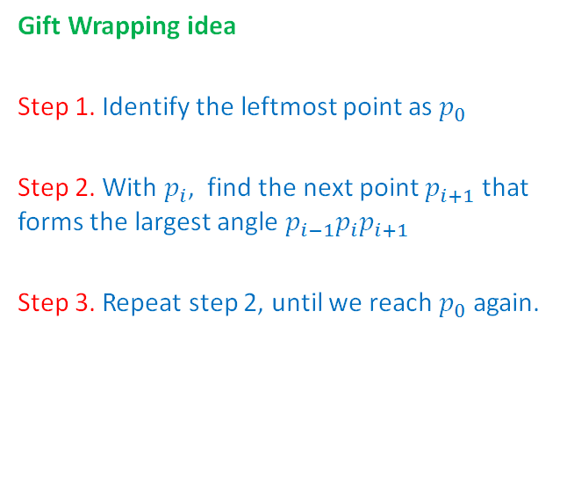
Jarvis March

Slide 40
Find an extreme point
Choose a leftmost point as start point, if there are more than one points, choose the point with minimum y-coordinate.
6
7
4
5
3
2
8
1
0
Leftmost point with minimum y coordinate

Slide 41
Jarvis March
Y
Find a next point P that virtual point, start point and this point can form the biggest angle.
pv, p0, p7 form the biggest angle.
6
7
4
5
3
2
8
1
0
virtual point pv (0, -∞)

Slide 42
6
Point 6 forms the biggest angle with point 7 and 0
7
4
5
3
2
8
1
0

Slide 43
Collinear
6
Point 2 forms the biggest angle with point 6 and 7.
7
4
5
3
2
8
Farthest
1
0

Slide 44
6
Point 1 forms the biggest angle with point 2 and 6.
7
4
5
3
2
8
1
0

Slide 45
6
Point 0 forms the biggest angle with point 2 and 1.
7
4
5
3
2
8
1
0

Slide 46
6
It returns to start point 0, the algorithm ends here.
7
4
5
3
2
8
1
0

Slide 47
Time complexity
Order of n
Order of h
h : The number of points on convex hull
Time complexity: O(nh)

Slide 48
Graham Scan Algorithm
Step 1: Select an interior point as the origin.
Step 2: Each other point forms a polar angle, and all points sorted by polar angles
Step 3: Examines the points cause reflexive angles
Step 4: The remaining points are convex hull vertices

Slide 49

Orientation
Calculating Orientation
Three kinds of orientation for three points (a, b, c)
Clockwise (CW): right turn
Counterclockwise (CCW): left turn
Collinear (COLL): no turn
b
CW
a
c
c
CCW
a
b
The orientation can be characterized by the sign of the determinant △(a,b,c)
If △(a,b,c)<0 ⇒ clockwise
If △(a,b,c)=0 ⇒ collinear
If △(a,b,c)>0 ⇒ counterclockwise
c
b
COLL
a

Slide 50
The Graham scan (Illustration)
Y
P₂
P₁
P
P₀
P₃
P₅
P₄
X

Slide 51

Eliminates points (Illustration)
Y
P₀,P₁,P₂ (x₀,y₀) (x₁,y₁) (x₂,y₂)
P₄
P₃
P₂
P₅
If $det$ < 0
If $det$ > 0 If $det$ > 0
P₁
P₀
X
Start at the point with the lowest y coordinate

Slide 52
The Convex Hull Problem
Running time:
n log n

Slide 53
The Convex Hull Problem (Cont.)
Convex Hull ?
The Convex hull of a set of planar points is defined as the smallest convex polygon containing all of the points.

Slide 54
Convex Hull: Divide & Conquer
Preprocessing: sort the points by x-coordinate
Divide the set of points into two sets A and B:
A contains the left ⎣n/2⎦ points,
B contains the right ⎡n/2⎤ points
Recursively compute the convex hull of A
Recursively compute the convex hull of B
Merge the two convex hulls
A
B

Slide 55
Merging
Find upper and lower tangent
With those tangents the convex hull of A∪B can be computed from the convex hulls of A and the convex hull of B in O(n) linear time
A
B

Slide 56
Finding the lower tangent
3
a = rightmost point of A
b = leftmost point of B
while T=ab not lower tangent to both convex hulls of A and B do{
while T not lower tangent to convex hull of A do{ a=a-1 } while T not lower tangent to convex hull of B do{ b=b+1 } }
4
4=b
2
3
5
5
a=2
6
1
7
1
0
0
A
B
left turn
right turn
check with orientation test

Slide 57
Convex Hull: Runtime
Preprocessing: sort the points by x-coordinate
Divide the set of points into two sets A and B:
A contains the left ⎣n/2⎦ points,
B contains the right ⎡n/2⎤ points
Recursively compute the convex hull of A
Recursively compute the convex hull of B
Merge the two convex hulls
O(n log n) just once
O(1)
T(n/2)
T(n/2)
O(n)

Slide 58
Convex Hull: Runtime
Runtime Recurrence:
T(n) = 2 T(n/2) + cn
Solves to T(n) = Θ(n log n)

Slide 59
Recurrence (Just like merge sort recurrence)
Divide: Divide set of points in half.
Conquer: Recursively compute convex hulls of 2 halves.
Combine: Linear-time merge.
T(n) = 2 T(n/2) + O(n)
# subproblems
work dividing and combining
subproblem size

Slide 60
Recurrence (cont’d)
Θ(1) if n = 1;
T(n) =
2T(n/2) + Θ(n) if n > 1.
How do we solve T(n)? I.e., how do we find out if it is O(n) or O(n²) or …?

Slide 61
Use Divide-and-Conquer to Solve

Slide 62
Convex Hull Algorithm
Input : A set S of planar points
Output : A convex hull for S
Step 1: If S contains no more than five points, use exhaustive searching to find the convex hull and return.
Step 2: Find a median line perpendicular to the X-axis which divides S into S_{L} and S_{R}, with equal sizes.
Step 3: Recursively construct convex hulls for S_{L} and S_{R}, denoted as Hull(S_{L}) and Hull(S_{R}), respectively.
Step 4: Apply the merging procedure to merge Hull(S_{L}) and Hull(S_{R}) together to form a convex hull.

Slide 63
Use Divide-and-Conquer to Solve
L
Y
S_{L}
S_{R}
Use Graham scan
X

Slide 64
Use Divide-and-Conquer to Solve
L
Y
π/2
S_{L}
S_{R}
j
d
i
e
c
k
p
f
h
g
a
b
3π/2
X

Slide 65
Use Divide-and-Conquer to Solve
L
Y
Time Complexity：
T(n) = 2T(n/2) + O(n)
= O(nlogn)
S_{L}
S_{R}
j
d
i
e
c
k
f
h
g
a
b
X

Slide 66
Subset Sum Problem
Input: set of n positive integers, {w₀, …, w_{n-1}}, maximum weight W
Output: a subset S of the input set such that the sum of the elements of S ≤ W and there is no subset of the input set whose sum is greater than the sum of S and ≤ W
Notes:
Knapsack problem where value = weight

Slide 67
Linear-Time Selection

Slide 68
Linear-Time Selection
Task Find the k^{th} smallest element in an unsorted list in O(n)-time.
Such an algorithm could find the min in O(n)-time if k=0 or the max if k=n-1.
Such an algorithm could find the median in O(n)-time if k=⌈n/2⌉-1 (this definition allows the median of lists of even-length to always be elements of the list, as opposed to the average of two elements).
1
64
9
49
16
4
0
25
36
81

Slide 69
Linear-Time Selection
Finding the min and max Iterate through the list and keep track of the smallest and largest elements. Runtime O(n).
Finding the k^{th} smallest element (naive) Sort the list and return the element in index k of the sorted list.
1
64
9
49
16
4
0
25
36
81
k=3
0
1
4
9
16
25
36
49
64
81

Slide 70
Not Quite Linear-Time Selection
def naive_select(A, k):
A = mergesort(A)
return A[k]
Worst-case runtime Θ(n log(n))

Slide 71
Linear-Time Selection
Key Insight Select a pivot, partition around it, and recurse.
Suppose we want to find element k=3.
1
64
9
49
16
4
0
25
36
81

Slide 72
Linear-Time Selection
Key Insight Select a pivot, partition around it, and recurse.
Suppose we want to find element k=3.
1
64
9
49
16
4
0
25
36
81
Select a pivot at random (for now)

Slide 73
Linear-Time Selection
Key Insight Select a pivot, partition around it, and recurse.
Suppose we want to find element k=3.
1
64
9
49
16
4
0
25
36
81
Select a pivot at random (for now)
1
9
16
4
0
25
36
64
49
81
Partition around the pivot, such that all elements to the left are less than it and all elements to the right are greater than it (Notice that the halves remain unsorted.)
Find element k=3 in this half since 36 occupies index 6 and k=3 < 6.

Slide 74
Linear-Time Selection
Key Insight Select a pivot, partition around it, and recurse.
Suppose we want to find element k=3.
1
9
16
4
0
25
36
64
49
81

Slide 75
Linear-Time Selection
Key Insight Select a pivot, partition around it, and recurse.
Suppose we want to find element k=3.
1
9
16
4
0
25
36
64
49
81
Select another pivot at random (for now)

Slide 76
Linear-Time Selection
Key Insight Select a pivot, partition around it, and recurse.
Suppose we want to find element k=3.
1
9
16
4
0
25
36
64
49
81
Select another pivot at random (for now)
0
1
9
16
4
25
36
64
49
81
Partition around the pivot
Find element k=3-(1+1) in this half since 1 occupies index 1 and k=3 > 1.

Slide 77
Linear-Time Selection
Key Insight Select a pivot, partition around it, and recurse.
Suppose we want to find element k=3.
0
1
9
16
4
25
36
64
49
81
Select another pivot at random (for now)

Slide 78
Linear-Time Selection
Key Insight Select a pivot, partition around it, and recurse.
Suppose we want to find element k=3.
0
1
9
16
4
25
36
64
49
81
Select another pivot at random (for now)
0
1
4
9
16
25
36
64
49
81
Partition around the pivot
We found the element!

Slide 79
Linear-Time Selection
def select(A, k, c=100):
if len(A) <= c:
return naive_select(A, k)
pivot = random.choice(A)
left, right = partition_about_pivot(A, pivot)
if len(left) == k:
# The pivot is the kth smallest element!
return pivot
elif len(left) > k:
# The kth smallest element is left of the pivot
return select(left, k, c)
else:
# The kth smallest element is right of the pivot
return select(right, k-len(left)-1, c)

Slide 80
Linear-Time Selection
def select(A, k, c=100):
if len(A) <= c:
return naive_select(A, k)
pivot = random.choice(A)
left, right = partition_about_pivot(A, pivot)
if len(left) == k:
# The pivot is the kth smallest element!
return pivot
elif len(left) > k:
# The kth smallest element is left of the pivot
return select(left, k, c)
else:
# The kth smallest element is right of the pivot
return select(right, k-len(left)-1, c)

Slide 81
Linear-Time Selection
def select(A, k, c=100):
if len(A) <= c:
return naive_select(A, k)
pivot = random.choice(A)
left, right = partition_about_pivot(A, pivot)
if len(left) == k:
# The pivot is the kth smallest element!
return pivot
elif len(left) > k:
# The kth smallest element is left of the pivot
return select(left, k, c)
else:
# The kth smallest element is right of the pivot
return select(right, k-len(left)-1, c)

Slide 82
Linear-Time Selection
def select(A, k, c=100):
if len(A) <= c:
return naive_select(A, k)
pivot = random.choice(A)
left, right = partition_about_pivot(A, pivot)
if len(left) == k:
# The pivot is the kth smallest element!
return pivot
elif len(left) > k:
# The kth smallest element is left of the pivot
return select(left, k, c)
else:
# The kth smallest element is right of the pivot
return select(right, k-len(left)-1, c)

Slide 83
Linear-Time Selection
def select(A, k, c=100):
if len(A) <= c:
return naive_select(A, k)
pivot = random.choice(A)
left, right = partition_about_pivot(A, pivot)
if len(left) == k:
# The pivot is the kth smallest element!
return pivot
elif len(left) > k:
# The kth smallest element is left of the pivot
return select(left, k, c)
else:
# The kth smallest element is right of the pivot
return select(right, k-len(left)-1, c)

Slide 84
Linear-Time Selection
def select(A, k, c=100):
if len(A) <= c:
return naive_select(A, k)
pivot = random.choice(A)
left, right = partition_about_pivot(A, pivot)
if len(left) == k:
# The pivot is the kth smallest element!
return pivot
elif len(left) > k:
# The kth smallest element is left of the pivot
return select(left, k, c)
else:
# The kth smallest element is right of the pivot
return select(right, k-len(left)-1, c)

Slide 85
Linear-Time Selection
def select(A, k, c=100):
if len(A) <= c:
return naive_select(A, k)
pivot = random.choice(A)
left, right = partition_about_pivot(A, pivot)
if len(left) == k:
# The pivot is the kth smallest element!
return pivot
elif len(left) > k:
# The kth smallest element is left of the pivot
return select(left, k, c)
else:
# The kth smallest element is right of the pivot
return select(right, k-len(left)-1, c)
“Worst-case” runtime Θ(n²)

Slide 86
Linear-Time Selection
def select(A, k, c=100):
if len(A) <= c:
return naive_select(A, k)
pivot = random.choice(A)
left, right = partition_about_pivot(A, pivot)
if len(left) == k:
# The pivot is the kth smallest element!
return pivot
elif len(left) > k:
# The kth smallest element is left of the pivot
return select(left, k, c)
else:
# The kth smallest element is right of the pivot
return select(right, k-len(left)-1, c)
“Worst-case” runtime Θ(n²)
We’ll discuss this runtime later...

Slide 87
Linear-Time Selection
def select(A, k, c=100):
if len(A) <= c:
return naive_select(A, k)
pivot = random.choice(A)
left, right = partition_about_pivot(A, pivot)
if len(left) == k:
# The pivot is the kth smallest element!
return pivot
elif len(left) > k:
# The kth smallest element is left of the pivot
return select(left, k, c)
else:
# The kth smallest element is right of the pivot
return select(right, k-len(left)-1, c)
“Worst-case” runtime Θ(n²)
Note: this is different from the “worst-case” we saw for insertion sort (we’ll revisit during Randomized Algs).
We’ll discuss this runtime later...

Slide 88
Linear-Time Selection
def partition_about_pivot(A, pivot):
left, right = [], []
for i in range(len(A)):
if A[i] == pivot: continue
elif A[i] < pivot:
left.append(A[i])
else:
right.append(A[i])
return left, right

Slide 89
Linear-Time Selection
def partition_about_pivot(A, pivot):
left, right = [], []
for i in range(len(A)):
if A[i] == pivot: continue
elif A[i] < pivot:
left.append(A[i])
else:
right.append(A[i])
return left, right

Slide 90
Linear-Time Selection
def partition_about_pivot(A, pivot):
left, right = [], []
for i in range(len(A)):
if A[i] == pivot: continue
elif A[i] < pivot:
left.append(A[i])
else:
right.append(A[i])
return left, right

Slide 91
Linear-Time Selection
def partition_about_pivot(A, pivot):
left, right = [], []
for i in range(len(A)):
if A[i] == pivot: continue
elif A[i] < pivot:
left.append(A[i])
else:
right.append(A[i])
return left, right

Slide 92
Linear-Time Selection
def partition_about_pivot(A, pivot):
left, right = [], []
for i in range(len(A)):
if A[i] == pivot: continue
elif A[i] < pivot:
left.append(A[i])
else:
right.append(A[i])
return left, right

Slide 93
Linear-Time Selection
def partition_about_pivot(A, pivot):
left, right = [], []
for i in range(len(A)):
if A[i] == pivot: continue
elif A[i] < pivot:
left.append(A[i])
else:
right.append(A[i])
return left, right

Slide 94
Linear-Time Selection
def partition_about_pivot(A, pivot):
left, right = [], []
for i in range(len(A)):
if A[i] == pivot: continue
elif A[i] < pivot:
left.append(A[i])
else:
right.append(A[i])
return left, right
Worst-case runtime Θ(n)

Slide 95
Linear-Time Selection
Intuition Partition the list about a pivot selected at random, either return the pivot itself or recurse on the left or right sublists (but not both).
You might have two questions at this point…
Does this actually work?
Is it fast?
def select(A, k, c=100):
if len(A) <= c:
return naive_select(A, k)
pivot = random.choice(A)
left, right = partition_about_pivot(A, pivot)
if len(left) == k: return pivot
elif len(left) > k: return select(left, k, c)
else: return select(right, k-len(left)-1, c)

Slide 96
Linear-Time Selection
Intuition Partition the list about a pivot selected at random, either return the pivot itself or recurse on the left or right sublists (but not both).
You might have two questions at this point…
Does this actually work?
Is it fast?
def select(A, k, c=100):
if len(A) <= c:
return naive_select(A, k)
pivot = random.choice(A)
left, right = partition_about_pivot(A, pivot)
if len(left) == k: return pivot
elif len(left) > k: return select(left, k, c)
else: return select(right, k-len(left)-1, c)

Slide 97
Linear-Time Selection
Does this actually work? We’ve already seen an example!
Formally, similar to last time, we proceed by induction, inducting on the length of the input list.
def select(A, k, c=100):
if len(A) <= c:
return naive_select(A, k)
pivot = random.choice(A)
left, right = partition_about_pivot(A, pivot)
if len(left) == k: return pivot
elif len(left) > k: return select(left, k, c)
else: return select(right, k-len(left)-1, c)

Slide 98
Proving Correctness
def proof_of_correctness_helper(algorithm):
if algorithm.type == "iterative":
# 1) Find the loop invariant
# 2) Define the inductive hypothesis
# (internal state at iteration i)
# 3) Prove the base case (i=0)
# 4) Prove the inductive step (i => i+1)
# 5) Prove the conclusion (i=n => correct)
elif algorithm.type == "recursive":
# 1) Define the inductive hypothesis
# (correct for inputs of sizes 1 to i)
# 2) Prove the base case (i < small constant)
# 3) Prove the inductive step (i => i+1 OR
{1,2,...,i} => i+1)
# 4) Prove the conclusion (i=n => correct)
# TODO

Slide 99
Proving Correctness
Recall, there are four components in a proof by induction.
Inductive Hypothesis The algorithm works on input lists of length 1 to i.
Base case The algorithm works on input lists of length 1.
Inductive step If the algorithm works on input lists of length 1 to i, then it works on input lists of length i+1.
Conclusion If the algorithm works on input lists of length n, then it works on the entire list.

Slide 100
Proving Correctness
Formally, for select...

Slide 101
Proving Correctness
Formally, for select...
Inductive Hypothesis select(A,k) correctly finds the k^{th}-smallest element for inputs of length 1 to i.

Slide 102
Proving Correctness
Formally, for select...
Inductive Hypothesis select(A,k) correctly finds the k^{th}-smallest element for inputs of length 1 to i.
Base case select(A,k) correctly finds the smallest element for inputs of length 1; it returns the element itself which is trivially the smallest.

Slide 103
Proving Correctness
Formally, for select...
Inductive Hypothesis select(A,k) correctly finds the k^{th}-smallest element for inputs of length 1 to i.
Base case select(A,k) correctly finds the smallest element for inputs of length 1; it returns the element itself which is trivially the smallest.
Inductive step Suppose the algorithm works on input lists of length 1 to i. Calling select(A,k) on an input list of length i+1 selects a pivot, partitions around it, and compares the length of the left list to k. There are three cases:

Slide 104
Proving Correctness
Formally, for select...
Inductive Hypothesis select(A,k) correctly finds the k^{th}-smallest element for inputs of length 1 to i.
Base case select(A,k) correctly finds the smallest element for inputs of length 1; it returns the element itself which is trivially the smallest.
Inductive step Suppose the algorithm works on input lists of length 1 to i. Calling select(A,k) on an input list of length i+1 selects a pivot, partitions around it, and compares the length of the left list to k. There are three cases:
len(left) == k: exactly k items less than the pivot, so return the pivot.
len(left) > k: More than k items less than the pivot, so return the k^{th}-smallest element of the left half of the list.
len(left) < k: There are fewer than k items ≤ to the pivot, so return the (k - len(left) - 1)^{st}-smallest element of the right half of the list.

Slide 105
Proving Correctness
Formally, for select...
Inductive Hypothesis select(A,k) correctly finds the k^{th}-smallest element for inputs of length 1 to i.
Base case select(A,k) correctly finds the smallest element for inputs of length 1; it returns the element itself which is trivially the smallest.
Inductive step Suppose the algorithm works on input lists of length 1 to i. Calling select(A,k) on an input list of length i+1 selects a pivot, partitions around it, and compares the length of the left list to k. There are three cases:
len(left) == k: exactly k items less than the pivot, so return the pivot.
len(left) > k: More than k items less than the pivot, so return the k^{th}-smallest element of the left half of the list.
len(left) < k: There are fewer than k items ≤ to the pivot, so return the (k - len(left) - 1)^{st}-smallest element of the right half of the list.
Conclusion The inductive hypothesis holds for all i. In particular, given an input list of any length n, select(A,k) correctly finds the k^{th}-smallest element!

Slide 106
Today’s Outline
Divide and Conquer II
Substitution method Done!
Linear-time selection
Proving correctness Done!
Proving runtime with recurrence relations
Problems: selection
Algorithms: Select
Reading: CLRS 9

Slide 107
Analyzing Runtime
Writing a recurrence relation for select gives:
def select(A, k, c=100):
if len(A) <= c:
return naive_select(A, k)
pivot = random.choice(A)
left, right = partition_about_pivot(A, pivot)
if len(left) == k: return pivot
elif len(left) > k: return select(left, k, c)
else: return select(right, k-len(left)-1, c)

Slide 108
Analyzing Runtime
Writing a recurrence relation for select gives:
{
O(n) len(L) == k
T(len(left)) + O(n) len(left) > k
T(len(right)) + O(n) len(left) < k
T(n) =
def select(A, k, c=100):
if len(A) <= c:
return naive_select(A, k)
pivot = random.choice(A)
left, right = partition_about_pivot(A, pivot)
if len(left) == k: return pivot
elif len(left) > k: return select(left, k, c)
else: return select(right, k-len(left)-1, c)

Slide 109
Analyzing Runtime
{
Writing a recurrence relation for select gives:
O(n) len(L) == k
T(len(left)) + O(n) len(left) > k
T(len(right)) + O(n) len(left) < k
T(n) =
The runtime for the recursive call to select
def select(A, k, c=100):
if len(A) <= c:
return naive_select(A, k)
pivot = random.choice(A)
left, right = partition_about_pivot(A, pivot)
if len(left) == k: return pivot
elif len(left) > k: return select(left, k, c)
else: return select(right, k-len(left)-1, c)

Slide 110
Analyzing Runtime
{
Writing a recurrence relation for select gives:
O(n) len(L) == k
T(len(left)) + O(n) len(left) > k
T(len(right)) + O(n) len(left) < k
T(n) =
The runtime for the recursive call to select
The runtime to partition
about the chosen pivot
def select(A, k, c=100):
if len(A) <= c:
return naive_select(A, k)
pivot = random.choice(A)
left, right = partition_about_pivot(A, pivot)
if len(left) == k: return pivot
elif len(left) > k: return select(left, k, c)
else: return select(right, k-len(left)-1, c)

Slide 111
Analyzing Runtime
{
Writing a recurrence relation for select gives:
O(n) len(L) == k
T(len(left)) + O(n) len(left) > k
T(len(right)) + O(n) len(left) < k
T(n) =
len(left) and len(right) depend on how we pick the pivot!
The runtime for the recursive call to select
The runtime to partition
about the chosen pivot
def select(A, k, c=100):
if len(A) <= c:
return naive_select(A, k)
pivot = random.choice(A)
left, right = partition_about_pivot(A, pivot)
if len(left) == k: return pivot
elif len(left) > k: return select(left, k, c)
else: return select(right, k-len(left)-1, c)

Slide 112
Analyzing Runtime in an Ideal World
len(left) and len(right) determine the runtime of the recursive calls to select.
In an ideal world, we split the input exactly in half, such that: len(left) = len(right) = (n-1)/2.
Then we could use Master Theorem!
What’s the recurrence?
{
Suppose T(n) = a⋅T(n/b) + O(n^{d}). The Master method states:
O(n^{d}logn) if a = b^{d}
O(n^{d}) if a < b^{d}
O(n^{log_b(a)}) if a > b^{d}
T(n) =

Slide 113
Analyzing Runtime in an Ideal World
len(left) and len(right) determine the runtime of the recursive calls to select.
In an ideal world, we split the input exactly in half, such that: len(left) = len(right) = (n-1)/2.
Then we could use Master Theorem!
What’s the recurrence? T(n) ≤ T(n/2) + O(n)
{
Suppose T(n) = a⋅T(n/b) + O(n^{d}). The Master method states:
O(n^{d}logn) if a = b^{d}
O(n^{d}) if a < b^{d}
O(n^{log_b(a)}) if a > b^{d}
T(n) =

Slide 114
Analyzing Runtime in an Ideal World
len(left) and len(right) determine the runtime of the recursive calls to select.
In an ideal world, we split the input exactly in half, such that: len(left) = len(right) = (n-1)/2.
Then we could use Master Theorem!
What’s the recurrence? T(n) ≤ T(n/2) + O(n)
Then, a = 1, b = 2, d = 1
{
Suppose T(n) = a⋅T(n/b) + O(n^{d}). The Master method states:
O(n^{d}logn) if a = b^{d}
O(n^{d}) if a < b^{d}
O(n^{log_b(a)}) if a > b^{d}
T(n) =

Slide 115
Analyzing Runtime in an Ideal World
len(left) and len(right) determine the runtime of the recursive calls to select.
In an ideal world, we split the input exactly in half, such that: len(left) = len(right) = (n-1)/2.
Then we could use Master Theorem!
What’s the recurrence? T(n) ≤ T(n/2) + O(n)
Then, a = 1, b = 2, d = 1 (Case 2: a < b^{d})
{
Suppose T(n) = a⋅T(n/b) + O(n^{d}). The Master method states:
O(n^{d}logn) if a = b^{d}
O(n^{d}) if a < b^{d}
O(n^{log_b(a)}) if a > b^{d}
T(n) =

Slide 116
Analyzing Runtime in an Ideal World
len(left) and len(right) determine the runtime of the recursive calls to select.
In an ideal world, we split the input exactly in half, such that: len(left) = len(right) = (n-1)/2.
Then we could use Master Theorem!
What’s the recurrence? T(n) ≤ T(n/2) + O(n)
Then, a = 1, b = 2, d = 1 (Case 2: a < b^{d})
T(n) ≤ O(n^{d}) = O(n)
{
Suppose T(n) = a⋅T(n/b) + O(n^{d}). The Master method states:
O(n^{d}logn) if a = b^{d}
O(n^{d}) if a < b^{d}
O(n^{log_b(a)}) if a > b^{d}
T(n) =

Slide 117
Analyzing Runtime
len(left) and len(right) determine the runtime of the recursive calls to select.
If we get super unlucky, we split the input, such that: len(left) = n - 1 and len(right) = 1 or vice versa.
Then it would be a lot slower.
T(n) ≤ T(n-1) + O(n)
Then, O(n) levels of O(n)
T(n) ≤ O(n²)

Slide 118
Linear-Time Selection
def select(A, k, c=100):
if len(A) <= c:
return naive_select(A, k)
pivot = random.choice(A)
left, right = partition_about_pivot(A, pivot)
if len(left) == k:
# The pivot is the kth smallest element!
return pivot
elif len(left) > k:
# The kth smallest element is left of the pivot
return select(left, k, c)
else:
# The kth smallest element is right of the pivot
return select(right, k-len(left)-1, c)
“Worst-case” runtime Θ(n²)

Slide 119
Linear-Time Selection
def select(A, k, c=100):
if len(A) <= c:
return naive_select(A, k)
pivot = random.choice(A)
left, right = partition_about_pivot(A, pivot)
if len(left) == k:
# The pivot is the kth smallest element!
return pivot
elif len(left) > k:
# The kth smallest element is left of the pivot
return select(left, k, c)
else:
# The kth smallest element is right of the pivot
return select(right, k-len(left)-1, c)
“Worst-case” runtime Θ(n²)
We discussed this runtime from earlier!

Slide 120
Analyzing Runtime
Recall pivot = random.choice(A) i.e. we randomly chose the pivot.
It’s possible to get unlucky, thus leading to runtime of Θ(n²).
We’ll formalize this unluckiness when we study Randomized Algs.
How might we pick a better pivot?
After all, it’s called linear-time selection, which implies Θ(n)-time.

Slide 121
Analyzing Runtime
Recall in an ideal world, we split the input exactly in half, such that: len(left) = len(right) = (n-1)/2.
Key Insight The ideal world requires us to pick the pivot that divides the input list in half

Slide 122
Analyzing Runtime
Recall in an ideal world, we split the input exactly in half, such that: len(left) = len(right) = (n-1)/2.
Key Insight The ideal world requires us to pick the pivot that divides the input list in half aka the median

Slide 123
Analyzing Runtime
Recall in an ideal world, we split the input exactly in half, such that: len(left) = len(right) = (n-1)/2.
Key Insight The ideal world requires us to pick the pivot that divides the input list in half aka the median aka select(A, k=⌈n/2⌉-1).
To approximate the ideal world, the linear-time select algorithm picks the pivot that divides the input list approximately in half aka close to the median.

Slide 124
Reasonable
Analyzing Runtime in an Ideal World
len(left) and len(right) determine the runtime of the recursive calls to select.
In a reasonable world, we split the input roughly in half, such that: 3n/10 < len(left), len(right) < 7n/10.
Once again, we could use Master Theorem!
What’s the recurrence?
{
Suppose T(n) = a⋅T(n/b) + O(n^{d}). The Master method states:
O(n^{d}logn) if a = b^{d}
O(n^{d}) if a < b^{d}
O(n^{log_b(a)}) if a > b^{d}
T(n) =

Slide 125
Reasonable
Analyzing Runtime in an Ideal World
len(left) and len(right) determine the runtime of the recursive calls to select.
In a reasonable world, we split the input roughly in half, such that: 3n/10 < len(left), len(right) < 7n/10.
Once again, we could use Master Theorem!
What’s the recurrence? T(n) ≤ T(7n/10) + O(n)
{
Suppose T(n) = a⋅T(n/b) + O(n^{d}). The Master method states:
O(n^{d}logn) if a = b^{d}
O(n^{d}) if a < b^{d}
O(n^{log_b(a)}) if a > b^{d}
T(n) =

Slide 126
Reasonable
Analyzing Runtime in an Ideal World
len(left) and len(right) determine the runtime of the recursive calls to select.
In a reasonable world, we split the input roughly in half, such that: 3n/10 < len(left), len(right) < 7n/10.
Once again, we could use Master Theorem!
What’s the recurrence? T(n) ≤ T(7n/10) + O(n)
Then, a = 1, b = 10/7, d = 1
{
Suppose T(n) = a⋅T(n/b) + O(n^{d}). The Master method states:
O(n^{d}logn) if a = b^{d}
O(n^{d}) if a < b^{d}
O(n^{log_b(a)}) if a > b^{d}
T(n) =

Slide 127
Reasonable
Analyzing Runtime in an Ideal World
len(left) and len(right) determine the runtime of the recursive calls to select.
In a reasonable world, we split the input roughly in half, such that: 3n/10 < len(left), len(right) < 7n/10.
Once again, we could use Master Theorem!
What’s the recurrence? T(n) ≤ T(7n/10) + O(n)
Then, a = 1, b = 10/7, d = 1 (Case 2: a < b^{d})
{
Suppose T(n) = a⋅T(n/b) + O(n^{d}). The Master method states:
O(n^{d}logn) if a = b^{d}
O(n^{d}) if a < b^{d}
O(n^{log_b(a)}) if a > b^{d}
T(n) =

Slide 128
Reasonable
Analyzing Runtime in an Ideal World
len(left) and len(right) determine the runtime of the recursive calls to select.
In a reasonable world, we split the input roughly in half, such that: 3n/10 < len(left), len(right) < 7n/10.
Once again, we could use Master Theorem!
What’s the recurrence? T(n) ≤ T(7n/10) + O(n)
Then, a = 1, b = 10/7, d = 1 (Case 2: a < b^{d})
T(n) ≤ O(n^{d}) = O(n)
{
Suppose T(n) = a⋅T(n/b) + O(n^{d}). The Master method states:
O(n^{d}logn) if a = b^{d}
O(n^{d}) if a < b^{d}
O(n^{log_b(a)}) if a > b^{d}
T(n) =

Slide 129
Reasonable
Analyzing Runtime in an Ideal World
len(left) and len(right) determine the runtime of the recursive calls to select.
In a reasonable world, we split the input roughly in half, such that: 3n/10 < len(left), len(right) < 7n/10.
1
9
16
4
0
25
36
64
49
81
The goal is to pick a pivot such that
3n/10 < len(left) < 7n/10 and 3n/10 < len(right) < 7n/10

Slide 130
Reasonable
Analyzing Runtime in an Ideal World
len(left) and len(right) determine the runtime of the recursive calls to select.
In a reasonable world, we split the input roughly in half, such that: 3n/10 < len(left), len(right) < 7n/10.
1
9
16
4
0
25
36
64
49
81
The goal is to pick a pivot such that
3n/10 < len(left) < 7n/10 and 3n/10 < len(right) < 7n/10

Slide 131
Reasonable
Analyzing Runtime in an Ideal World
len(left) and len(right) determine the runtime of the recursive calls to select.
In a reasonable world, we split the input roughly in half, such that: 3n/10 < len(left), len(right) < 7n/10.
1
9
16
4
0
25
36
64
49
81
The goal is to pick a pivot such that
3n/10 < len(left) < 7n/10 and 3n/10 < len(right) < 7n/10

Slide 132
Finding a Good Pivot
Recall: We recurse on one of the two pieces of the array if we don't immediately find the element we want.
A good pivot should split the array so that each piece is some constant fraction of the size of the array.
(Those sizes don't have to be the same.)

Slide 133
Finding a Good Pivot
Recall: We recurse on one of the two pieces of the array if we don't immediately find the element we want.
A good pivot should split the array so that each piece is some constant fraction of the size of the array.
(Those sizes don't have to be the same.)
1 / 2 | 1 / 2

Slide 134

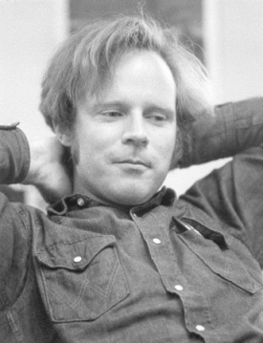



BFPRT Algorithm
A very clever “choose” algorithm . . .
Split into n/5 sets of size 5
M be the set of medians of these sets
Return x = the median of M
M. Blum
R. Floyd
V. Pratt
R. Rivest
R. Tarjan

Slide 135
BFPRT runtime
Split into n/5 sets of size 5
Let M be the set of medians of these sets
Choose x to be the median of M
Construct S₁ , S₂ and S₃ as above
Recursive call in S₁ or S₃
To show: |S₁| < 3n/4, |S₃| < 3n/4
n/5 + 3n/4 = 0.95n ⇒ O(n), worst case

Slide 136
Median of Medians
small large
x = median of medians
NB: conceptual; algorithm finds median(s), but does not sort

Slide 137
Median of Medians
Points ≥ x, ∴ NOT in S₁
≈ 3n/10 of them
small large
Bottom Line: recursive call on S₁ or S₃ includes only about 70% of points
x = median of medians
Points ≤ x, ∴ NOT in S₃
≈ 3n/10 of them
NB: conceptual; algorithm finds median(s), but does not sort

Slide 138
The Median of Medians
Arrange the numbers in groups of five
………………..
2
54
44
4
25
………………..
5
32
18
39
………………..
………………..
5
47
………………..
9
87
21
26
………………..
19
9
13
16
56
………………..
………………..
24
10
2
19
71
………………..
………………..

Slide 139
Find median of N/5 groups
………………..
2
5
2
4
25
………………..
5
13
16
39
………………..
………………..
9
………………..
9
10
21
18
47
………………..
19
54
32
19
56
………………..
………………..
24
87
44
26
71
………………..
………………..
Median of each group

Slide 140
Find the Median of each group
………………..
2
5
2
4
25
………………..
3.n/10
………………..
………………..
5
9
13
16
39
47
………………..
9
10
21
18
………………..
19
54
32
19
56
………………..
………………..
24
87
44
26
71
………………..
………………..
Find m ,the median of medians

Slide 141
Find the sets L and R
Compare each n-1 elements with the median m and find two sets L and R such that every element in L is smaller than M and every element in R is greater than m.
m
L
R
3n/10<L<7n/10
3n/10<R<7n/10

Slide 142
Another Divide and Conquer Algorithm
We can’t solve select(A,n/2) (yet).
But we can solve select(B,m/2) for len(B) = m < n.
How does having an algorithm that can find the median of smaller lists help us?

Slide 143
Another Divide and Conquer Algorithm
We can’t solve select(A,n/2) (yet).
But we can solve select(B,m/2) for len(B) = m < n.
How does having an algorithm that can find the median of smaller lists help us?
Pro tip: making the inductive hypothesis i.e. assuming correctness of the algorithm on smaller inputs is a helpful technique for designing divide and conquer algorithms.

Slide 144
Another Divide and Conquer Algorithm
We can’t solve select(A,n/2) (yet).
But we can solve select(B,m/2) for len(B) = m < n.
How does having an algorithm that can find the median of smaller lists help us? It can help us pick a pivot that’s close to the median.
Pro tip: making the inductive hypothesis i.e. assuming correctness of the algorithm on smaller inputs is a helpful technique for designing divide and conquer algorithms.

Slide 145
Another Divide and Conquer Algorithm
Goal: Use an algorithm that can find the median of smaller lists to help pick a pivot that’s close to the median of the original list.

Slide 146
Another Divide and Conquer Algorithm
Goal: Use an algorithm that can find the median of smaller lists to help pick a pivot that’s close to the median of the original list.
Divide the original list into small groups.

Slide 147
Another Divide and Conquer Algorithm
Goal: Use an algorithm that can find the median of smaller lists to help pick a pivot that’s close to the median of the original list.
Divide the original list into small groups.
Find the sub-median of each small group.
{
{
{
{
{
{
{
{
{
{
{
{
sub-median
sub-median
sub-median
sub-median
sub-median
sub-median
sub-median
sub-median
sub-median
sub-median
sub-median
sub-median

Slide 148
Another Divide and Conquer Algorithm
Goal: Use an algorithm that can find the median of smaller lists to help pick a pivot that’s close to the median of the original list.
Divide the original list into small groups.
Find the sub-median of each small group.
Find the median of all of the sub-medians.
{
{
{
{
{
{
{
{
{
{
{
{
sub-median
sub-median
sub-median
sub-median
sub-median
sub-median
sub-median
sub-median
sub-median
sub-median
sub-median
sub-median
median of sub-medians

Slide 149
Another Divide and Conquer Algorithm
Goal: Use an algorithm that can find the median of smaller lists to help pick a pivot that’s close to the median of the original list.
Divide the original list into small groups.
Find the sub-median of each small group.
Find the median of all of the sub-medians.
{
{
{
{
{
{
{
{
{
{
{
{
sub-median
sub-median
sub-median
sub-median
sub-median
sub-median
sub-median
sub-median
sub-median
sub-median
sub-median
sub-median
median of sub-medians
≈
median of the whole list

Slide 150
Another Divide and Conquer Algorithm
2
11
9
3
13
5
16
4
6
12
...
19
14

Slide 151
Another Divide and Conquer Algorithm
2
11
9
3
13
5
16
4
6
12
...
19
14
Divide A into g = ⌈n/5⌉ groups
of at most 5 elements
2
5
17
8
22
11
16
23
18
19
9
4
10
15
14
at most 5 elements
3
6
7
1
13
12
21
20
g = ⌈n/5⌉ groups

Slide 152
Another Divide and Conquer Algorithm
2
11
9
3
13
5
16
4
6
12
...
19
14
Divide A into g = ⌈n/5⌉ groups
of at most 5 elements
2
5
17
8
22
11
16
23
18
19
Find the sub-median of each of the groups (yellow) and recursively call select to find the median of these sub-medians (pink).
9
4
10
15
14
at most 5 elements
3
6
7
1
2
5
17
8
22
13
12
21
20
11
16
23
18
19
g = ⌈n/5⌉ groups
9
4
10
15
14
3
6
7
1
13
12
21
20

Slide 153
Linear-Time Selection
def select(A, k, c=100):
if len(A) <= c:
return naive_select(A, k)
pivot = random.choice(A)
left, right = partition_about_pivot(A, pivot)
if len(left) == k:
# The pivot is the kth smallest element!
return pivot
elif len(left) > k:
# The kth smallest element is left of the pivot
return select(left, k, c)
else:
# The kth smallest element is right of the pivot
return select(right, k-len(left)-1, c)
“Worst-case” runtime Θ(n²)

Slide 154
Linear-Time Selection
def select(A, k, c=100):
if len(A) <= c:
return naive_select(A, k)
pivot = random.choice(A) median_of_medians(A)
left, right = partition_about_pivot(A, pivot)
if len(left) == k:
# The pivot is the kth smallest element!
return pivot
elif len(left) > k:
# The kth smallest element is left of the pivot
return select(left, k, c)
else:
# The kth smallest element is right of the pivot
return select(right, k-len(left)-1, c)

Slide 155
Analyzing Runtime
Clearly, the median of medians (15) is not necessarily the actual median (12), but we claim that it’s guaranteed to be pretty close.
2
5
17
8
22
11
16
23
18
19
9
4
10
15
14
3
6
7
1
13
12
21
20

Slide 156
Analyzing Runtime
To see why, partition elements within each of the groups around the group’s median, and partition the groups around the group with the median of medians.
At least how many elements are guaranteed to be smaller than the median of medians?
2
5
8
10
22
3
4
1
7
19
9
6
15
17
14
11
16
18
23
13
12
20
21

Slide 157
Analyzing Runtime
To see why, partition elements within each of the groups around the group’s median, and partition the groups around the group with the median of medians.
At least how many elements are guaranteed to be smaller than the median of medians? At least these (1, 2, 3, 4, 5, 6, 8, 9). There might be more (7, 11, 12, 13, 14), but we are guaranteed that at least these will be smaller.
2
5
8
10
22
3
4
1
7
19
9
6
15
17
14
11
16
18
23
13
12
20
21

Slide 158
Analyzing Runtime
To see why, partition elements within each of the groups around the group’s median, and partition the groups around the group with the median of medians.
At least how many elements are guaranteed to be smaller than the median of medians? At least these (1, 2, 3, 4, 5, 6, 8, 9). There might be more (7, 11, 12, 13, 14), but we are guaranteed that at least these will be smaller.
2 elements from the small group containing the median of medians.
2
5
8
10
22
3 elements from each small group with a median smaller than the median of medians.
3
4
1
7
19
9
6
15
17
14
11
16
18
23
13
12
20
21

Slide 159
Analyzing Runtime
As a function of n (the size of the original list), how many elements are guaranteed to be smaller than the median of medians?
Let g = ⌈n/5⌉ represent the number of groups.
At least 3⋅(⌈g/2⌉ - 1 - 1) + 2 elements.
To exclude the list with the median of medians.
2 elements from the small group containing the median of medians.
2
5
8
10
22
3 elements from each small group with a median smaller than the median of medians.
3
4
1
7
19
9
6
15
17
14
11
16
18
23
13
12
20
21

Slide 160
Analyzing Runtime
As a function of n (the size of the original list), how many elements are guaranteed to be smaller than the median of medians?
Let g = ⌈n/5⌉ represent the number of groups.
At least 3⋅(⌈g/2⌉ - 1 - 1) + 2 elements.
To exclude the list with the median of medians.
To exclude the list with the leftovers.
2 elements from the small group containing the median of medians.
2
5
8
10
22
3 elements from each small group with a median smaller than the median of medians.
3
4
1
7
19
9
6
15
17
14
11
16
18
23
13
12
20
21

Slide 161
Analyzing Runtime
If at least 3⋅(⌈g/2⌉ - 2) + 2 elements are guaranteed to be smaller than the median of medians, at most how many elements are larger than the median of medians?
At most n - 1 - (3⋅(⌈g/2⌉ - 2) + 2)
n-1 is for all of the elements except for the median of medians.
2
5
8
10
22
At most everything besides these elements
3
4
1
7
19
9
6
15
17
14
11
16
18
23
13
12
20
21

Slide 162
Analyzing Runtime
If at least 3⋅(⌈g/2⌉ - 2) + 2 elements are guaranteed to be smaller than the median of medians, at most how many elements are larger than the median of medians?
At most n - 1 - (3⋅(⌈g/2⌉ - 2) + 2) ≤ 7n/10 + 3 elements.
n-1 is for all of the elements except for the median of medians.
2
5
8
10
22
At most everything besides these elements
3
4
1
7
19
9
6
15
17
14
11
16
18
23
13
12
20
21

Slide 163
Analyzing Runtime
median_of_medians will choose a pivot greater than at least
3⋅(⌈g/2⌉ - 2) + 2 ≥ 3n/10 - 4 elements.
We just showed that …
3n/10 - 4 ≤ len(left) ≤ 7n/10 + 3
3n/10 - 4 ≤ len(right) ≤ 7n/10 + 3
median_of_medians will choose a pivot less than at most 7n/10 + 3 elements.

Slide 164
Analyzing Runtime
median_of_medians will choose a pivot greater than at least
3⋅(⌈g/2⌉ - 2) + 2 ≥ 3n/10 - 4 elements.
We just showed that …
3n/10 - 4 ≤ len(left) ≤ 7n/10 + 3
3n/10 - 4 ≤ len(right) ≤ 7n/10 + 3
We can just as easily show the inverse.
median_of_medians will choose a pivot less than at most 7n/10 + 3 elements.

Slide 165
Linear-Time Selection
def select(A, k, c=100):
if len(A) <= c:
return naive_select(A, k)
pivot = random.choice(A) median_of_medians(A)
left, right = partition_about_pivot(A, pivot)
if len(left) == k:
# The pivot is the kth smallest element!
return pivot
elif len(left) > k:
# The kth smallest element is left of the pivot
return select(left, k, c)
else:
# The kth smallest element is right of the pivot
return select(right, k-len(left)-1, c)

Slide 166
Analyzing Runtime
What’s the recurrence relation?
def select(A, k, c=100):
if len(A) <= c:
return naive_select(A, k)
pivot = median_of_medians(A)
left, right = partition_about_pivot(A, pivot)
if len(left) == k: return pivot
elif len(left) > k: return select(left, k, c)
else: return select(right, k-len(left)-1, c)

Slide 167
Analyzing Runtime
What’s the recurrence relation?
T(n) = nlog(n) when n ≤ 100
T(n) ≤ T(n/5) +
def select(A, k, c=100):
if len(A) <= c:
return naive_select(A, k)
pivot = median_of_medians(A)
left, right = partition_about_pivot(A, pivot)
if len(left) == k: return pivot
elif len(left) > k: return select(left, k, c)
else: return select(right, k-len(left)-1, c)

Slide 168
Analyzing Runtime
What’s the recurrence relation?
T(n) = nlog(n) when n ≤ 100
T(n) ≤ T(n/5) + T(7n/10) +
def select(A, k, c=100):
if len(A) <= c:
return naive_select(A, k)
pivot = median_of_medians(A)
left, right = partition_about_pivot(A, pivot)
if len(left) == k: return pivot
elif len(left) > k: return select(left, k, c)
else: return select(right, k-len(left)-1, c)

Slide 169
Analyzing Runtime
What’s the recurrence relation?
T(n) = nlog(n) when n ≤ 100
T(n) ≤ T(n/5) + T(7n/10) + O(n)
def select(A, k, c=100):
if len(A) <= c:
return naive_select(A, k)
pivot = median_of_medians(A)
left, right = partition_about_pivot(A, pivot)
if len(left) == k: return pivot
elif len(left) > k: return select(left, k, c)
else: return select(right, k-len(left)-1, c)

Slide 170
Analyzing Runtime
What’s the recurrence relation?
T(n) = nlog(n) when n ≤ 100
T(n) ≤ T(n/5) + T(7n/10) + O(n)
def select(A, k, c=100):
if len(A) <= c:
return naive_select(A, k)
pivot = median_of_medians(A)
left, right = partition_about_pivot(A, pivot)
if len(left) == k: return pivot
elif len(left) > k: return select(left, k, c)
else: return select(right, k-len(left)-1, c)

Slide 171
Analyzing Runtime
What’s the recurrence relation?
T(n) = nlog(n) when n ≤ 100
T(n) ≤ T(n/5) + T(7n/10) + O(n)
We can’t use Master Theorem!
def select(A, k, c=100):
if len(A) <= c:
return naive_select(A, k)
pivot = median_of_medians(A)
left, right = partition_about_pivot(A, pivot)
if len(left) == k: return pivot
elif len(left) > k: return select(left, k, c)
else: return select(right, k-len(left)-1, c)

Slide 172
Analyzing Runtime
What’s the recurrence relation?
T(n) = nlog(n) when n ≤ 100
T(n) ≤ T(n/5) + T(7n/10) + O(n)
We can’t use Master Theorem!
We use substitution method!
def select(A, k, c=100):
if len(A) <= c:
return naive_select(A, k)
pivot = median_of_medians(A)
left, right = partition_about_pivot(A, pivot)
if len(left) == k: return pivot
elif len(left) > k: return select(left, k, c)
else: return select(right, k-len(left)-1, c)

Slide 173
Substitution Method
T(n) = nlog(n) when n ≤ 100
T(n) ≤ T(n/5) + T(7n/10) + O(n)
Guess what the answer is.
Linear-time select
Comparing to mergesort recurence, less than n log(n)
Guess O(n)

Slide 174
Substitution Method
T(n) = nlog(n) when n ≤ 100
T(n) ≤ T(n/5) + T(7n/10) + O(n)
Formally prove that’s what the answer is.
Inductive hypothesis T(k) ≤ Ck for all 1 ≤ k < n.
Base case T(k) ≤ Ck for all k ≤ 100.
Inductive step
T(n) = T(n/5) + T(7n/10) + dn ≤ C(n/5) + C(7n/10) + dn = (C/5)n + (7C/10)n + dn ≤ Cn
Conclusion There exists some C = max{7, 10d} such that for all n > 1, T(n) ≤ Cn. Therefore, T(n) = O(n).
C is some constant we’ll have to fill in later!
C must be ≥ log(n) for n ≤ 100, so C ≥ 7.
Solve for C to satisfy the inequality. C ≥ 10d works.

Slide 175
Substitution Method
T(n) = nlog(n) when n ≤ 100
T(n) ≤ T(n/5) + T(7n/10) + O(n)
Formally prove that’s what the answer is.
Inductive hypothesis T(k) ≤ max{7, 10d}k for all 1 ≤ k < n.
Base case T(k) ≤ max{7, 10d}k for all k ≤ 100.
Inductive step
T(n) = T(n/5) + T(7n/10) + dn ≤ max{7, 10d}(n/5) + max{7, 10d}(7n/10) + dn = (max{7, 10d}/5)n + (7max{7, 10d}/10)n + dn ≤ max{7, 10d}n
Conclusion There exists some C = max{7, 10d} such that for all n > 1, T(n) ≤ max{7, 10d}n. Therefore, T(n) = O(n).

Slide 176
Substitution Method
Guess what the answer is.
Formally prove that’s what the answer is.
Might need to leave some constants unspecified until the end and see what they need to be for the proof to work.

Slide 177
Today’s Outline
Divide and Conquer II
Substitution method Done!
Linear-time selection
Proving correctness Done!
Proving runtime with recurrence relations Done!
Problems: selection
Algorithms: Select
Reading: CLRS 9

Slide 178
Linear-Time Selection
def select(A, k, c=100):
if len(A) <= c:
return naive_select(A, k)
pivot = random.choice(A) median_of_medians(A)
left, right = partition_about_pivot(A, pivot)
if len(left) == k:
# The pivot is the kth smallest element!
return pivot
elif len(left) > k:
# The kth smallest element is left of the pivot
return select(left, k, c)
else:
# The kth smallest element is right of the pivot
return select(right, k-len(left)-1, c)
Worst-case runtime Θ(n)

Slide 179
Linear-Time Selection
def select(A, k, c=100):
if len(A) <= c:
return naive_select(A, k)
pivot = random.choice(A) median_of_medians(A)
left, right = partition_about_pivot(A, pivot)
if len(left) == k:
# The pivot is the kth smallest element!
return pivot
elif len(left) > k:
# The kth smallest element is left of the pivot
return select(left, k, c)
else:
# The kth smallest element is right of the pivot
return select(right, k-len(left)-1, c)
Worst-case runtime Θ(n)
Note: back to talking about the same worst-case we saw for insertion sort (we’ll revisit during Randomized Algs).

Slide 180
Divide and Conquer van Emde Boas Trees

Slide 181
van Emde Boas Trees
Goal
We want to maintain n elements in the range {0, 1, 2, . . . , u − 1} and perform
Insert,
Delete and
Successor operations in O(log log u) time
Application: Network Routing Tables
u = Range of IP Addresses → port to send (u = 2³² in IPv4)

Slide 182
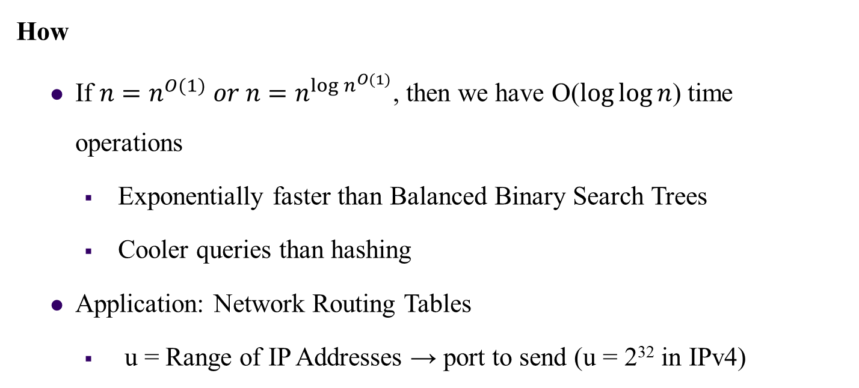
van Emde Boas Trees
How
If $n=n^{O(1)} or n=n^{{\log{n}}^{O(1)}}$, then we have O($\log{\log{n}}$) time operations
Exponentially faster than Balanced Binary Search Trees
Cooler queries than hashing
Application: Network Routing Tables
u = Range of IP Addresses → port to send (u = 2³² in IPv4)

Slide 183
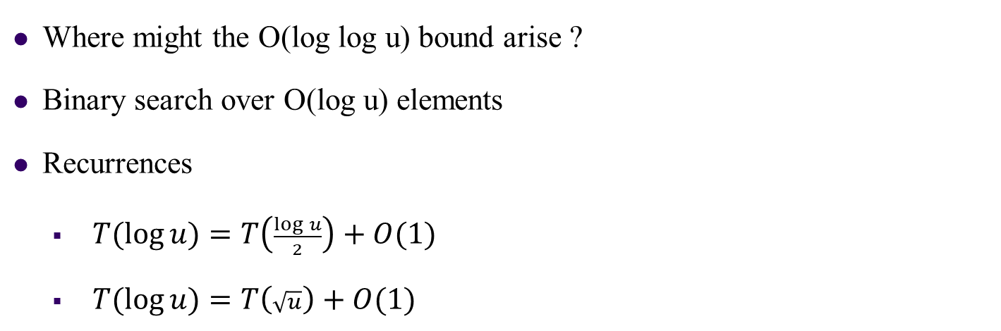
van Emde Boas Trees
Where might the O(log log u) bound arise ?
Binary search over O(log u) elements
Recurrences
$T(\log{u)=T\left(\frac{\log{u}}{2}\right)+O(1)}$
$T(\log{u)=T\left(\sqrt{u}\right)+O(1)}$
Improvements
We will develop the van Emde Boas data structure by a series of improvements on a very simple data structure

Slide 184
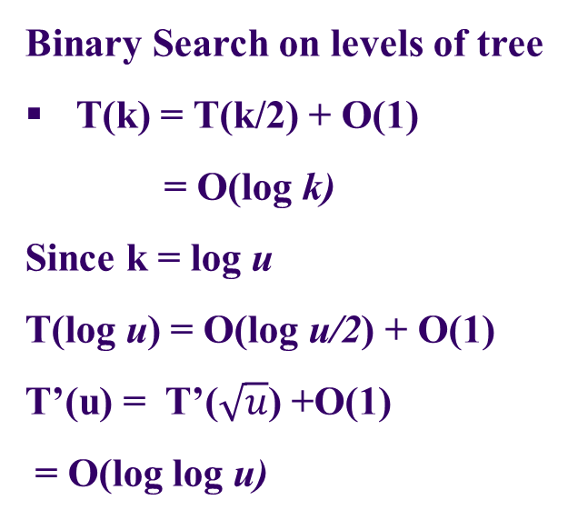
van Emde Boas Trees
Binary Search on levels of tree
T(k) = T(k/2) + O(1)
= O(log k)
Since k = log u
T(log u) = O(log u/2) + O(1)
T’(u) = T’($\sqrt{u}$) +O(1)
= O(log log u)
log u
u
What DS is suitable for constant time Insert and delete?

Slide 185
1. Bit Vector
We maintain a vector V of size u such that V[x] = 1 if and only if x is in the set. Now, inserts and deletes can be performed by just flipping the corresponding bit in the vector. However, successor/predecessor requires us to traverse through the vector to find the next 1-bit.
Insert/Delete: O(1)
Successor/Predecessor: O(u)
Bit vector for u = 16. The current set is {1, 9, 10, 15}.

Slide 186
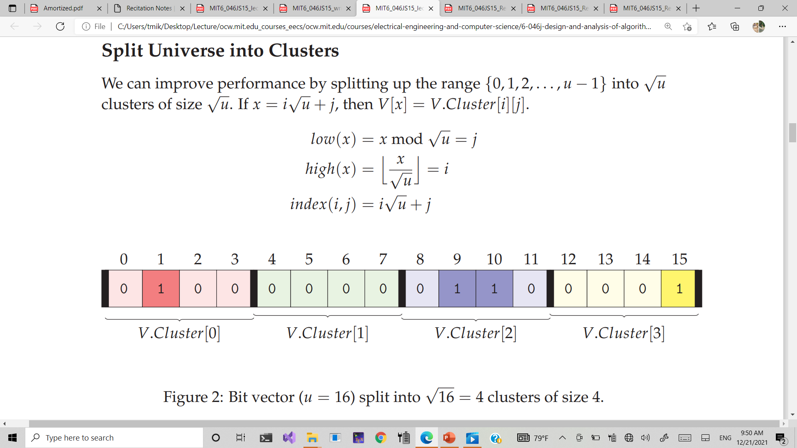
2. Split Universe into Clusters
We need to store both the bit vector and the summary vector
Summary Vector
1
0
1
1
OR
OR
OR
OR
1
0
0
0
1
1
0
1
OR
OR
OR
OR
OR
OR
OR
OR

Slide 187
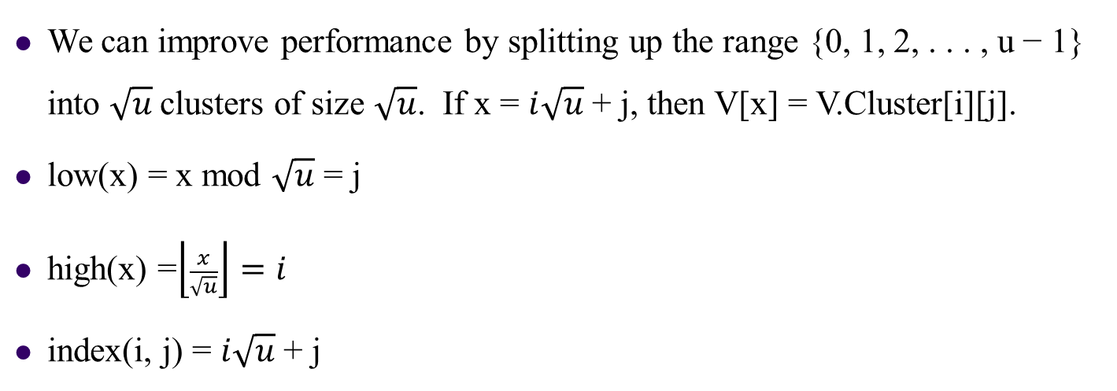
Split Universe into Clusters
We can improve performance by splitting up the range {0, 1, 2, . . . , u − 1} into $\sqrt{u}$clusters of size $\sqrt{u}$. If x = $i\sqrt{u}$ + j, then V[x] = V.Cluster[i][j].
low(x) = x mod $\sqrt{u}$ = j
high(x) =$\left\lfloor \frac{x}{\sqrt{u}}\right\rfloor =i$
index(i, j) = $i\sqrt{u}$ + j
Bit vector (u = 16) split into $\sqrt{16}$ = 4 clusters of size 4

Slide 188
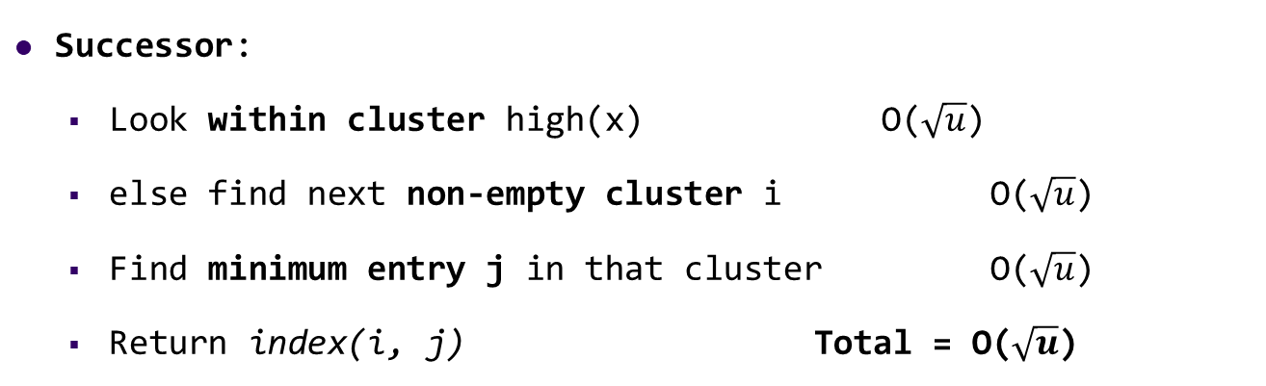
Insert
Insert
Set V.cluster[high(x)][low(x)] = 1 O(1)
Mark cluster high(x) as non-empty O(1)
Successor:
Look within cluster high(x) O($\sqrt{u}$)
else find next non-empty cluster i O($\sqrt{u}$)
Find minimum entry j in that cluster O($\sqrt{u}$)
Return index(i, j) Total = O($\sqrt{u}$)

Slide 189
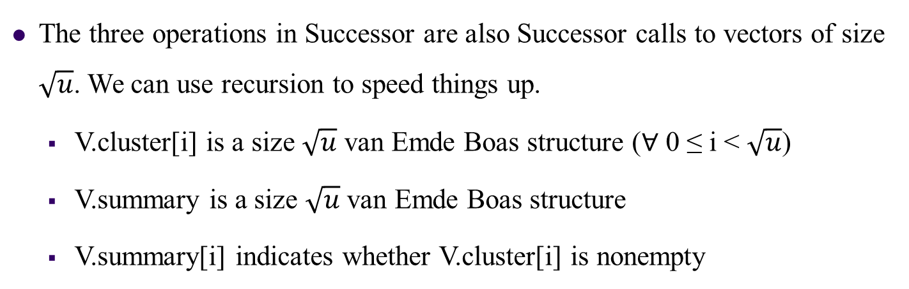
3. Recurse
The three operations in Successor are also Successor calls to vectors of size $\sqrt{u}$. We can use recursion to speed things up.
V.cluster[i] is a size $\sqrt{u}$ van Emde Boas structure (∀ 0 ≤ i < $\sqrt{u}$)
V.summary is a size $\sqrt{u}$ van Emde Boas structure
V.summary[i] indicates whether V.cluster[i] is nonempty

Slide 190
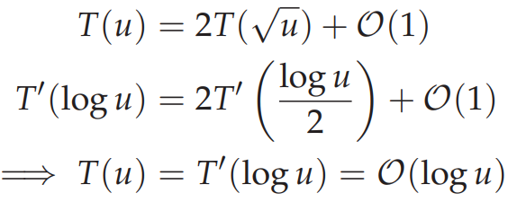
INSERT
INSERT(V, x)
1 Insert(V.cluster[high(x)], low[x])
2 Insert(V.summary, high[x])
So, we get the recurrence:

Slide 191
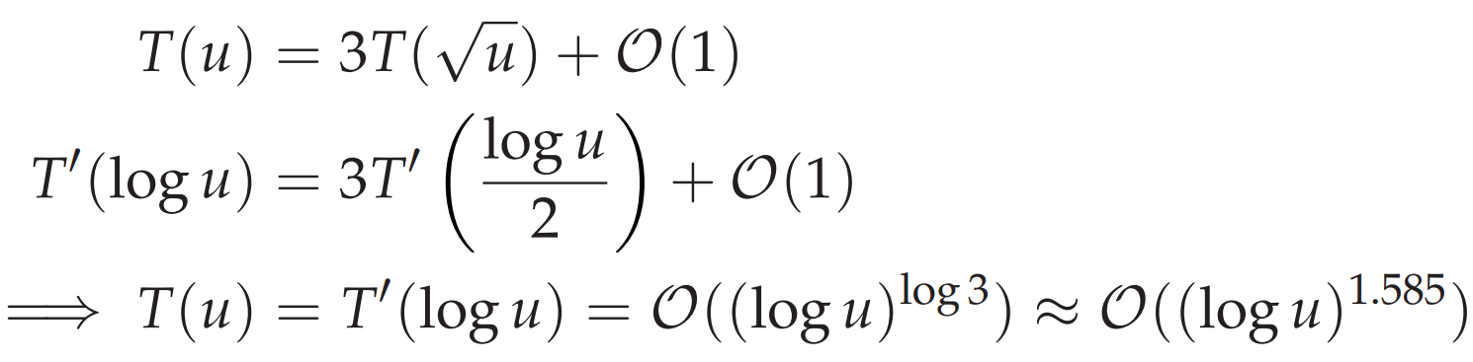
SUCCESSOR
SUCCESSOR(V, x)
1 i = high(x)
2 j = Successor(V.cluster[i], low(x))
3 if j == ∞
4 i = Successor(V.summary, i)
5 j = Successor(V.cluster[i], −∞)
6 return index(i, j)
Notes:
To obtain the O(log log u) running time, we need to reduce the number of recursions to one.

Slide 192
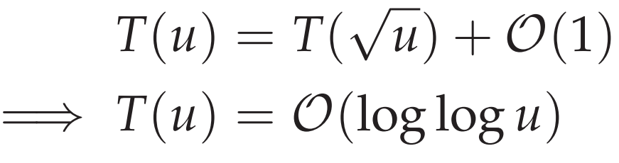
4. Maintain Min and Max
We store the minimum and maximum entry in each structure. This gives an O(1) time overhead for each Insert operation.
SUCCESSOR(V, x)
1 i = high(x)
2 if low(x) < V.cluster[i].max
3 j = Successor(V.cluster[i], low(x))
4 else: i = Successor(V.summary, high(x))
5 j = V.cluster[i].min
6 return index(i, j)

Slide 193
5. Don’t store Min recursively
The Successor call now needs to check for the min separately.
if x < V.min : return V.min
INSERT(V, x)
1 if V.min == None
2 V.min = V.max = x I O(1) time
3 return
4 if x < V.min
5 swap(x ↔ V.min)
6 if x > V.max
7 V.max = x)
8 if V.cluster[high(x) == None
9 Insert(V.summary, high(x))
10 Insert(V.cluster[high(x)], low(x))
If the first call is executed, the second call only takes O(1) time. So
►First Call 1
►Second Call

Slide 194
6. Delete
DELETE(V, x)
1 if x == V.min
2 i = V.summary.min
3 if i = None
4 V.min = V.max = None
5 return
6 V.min = index(i, V.cluster[i].min)
7 Delete(V.cluster[high(x)], low(x))
8 if V.cluster[high(x)].min == None
9 Delete(V.summary, high(x))
10 if x == V.max
11 if V.summary.max = None
12 else
13 i = V.summary.max
14 V.max = index(i, V.cluster[i].max)
► Find new min
If the second call is executed, the first call only takes O(1) time.
So
► O(1) time
► Unstore new min
► First Call
►Second Call
► Now we update V.max

Slide 195
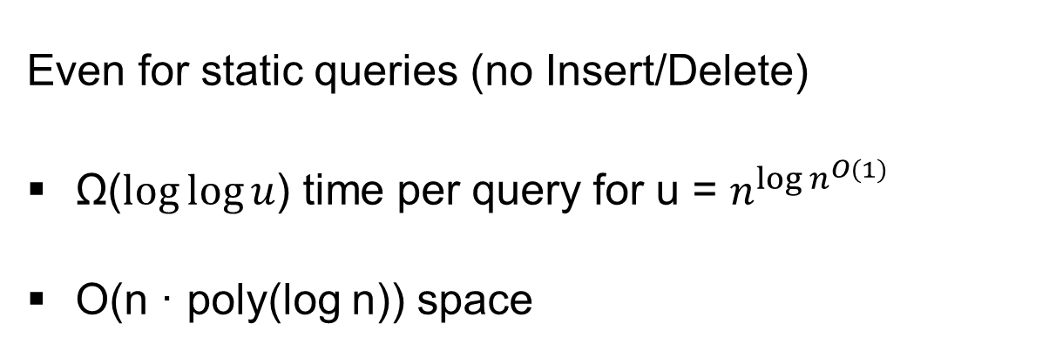
Lower Bound [Patrascu & Thorup 2007]
Even for static queries (no Insert/Delete)
Ω($\log{\log{u}}$) time per query for u = $n^{{\log{n}}^{O(1)}}$
O(n · poly(log n)) space

Slide 196
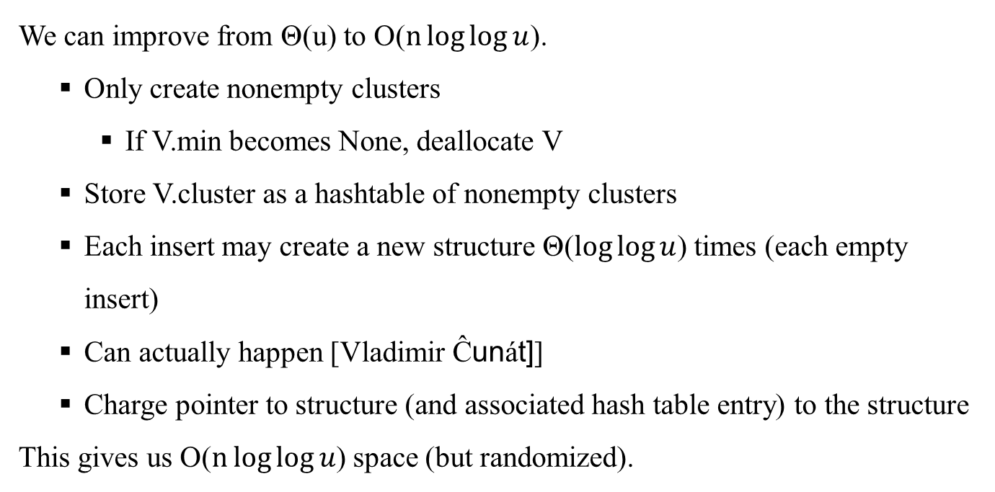
7. Space Improvements
We can improve from Θ(u) to O($n\log{\log{u}}$).
Only create nonempty clusters
If V.min becomes None, deallocate V
Store V.cluster as a hashtable of nonempty clusters
Each insert may create a new structure Θ($\log{\log{u}}$) times (each empty insert)
Can actually happen [Vladimir Ĉunát]]
Charge pointer to structure (and associated hash table entry) to the structure
This gives us O($n\log{\log{u}}$) space (but randomized).

Slide 197
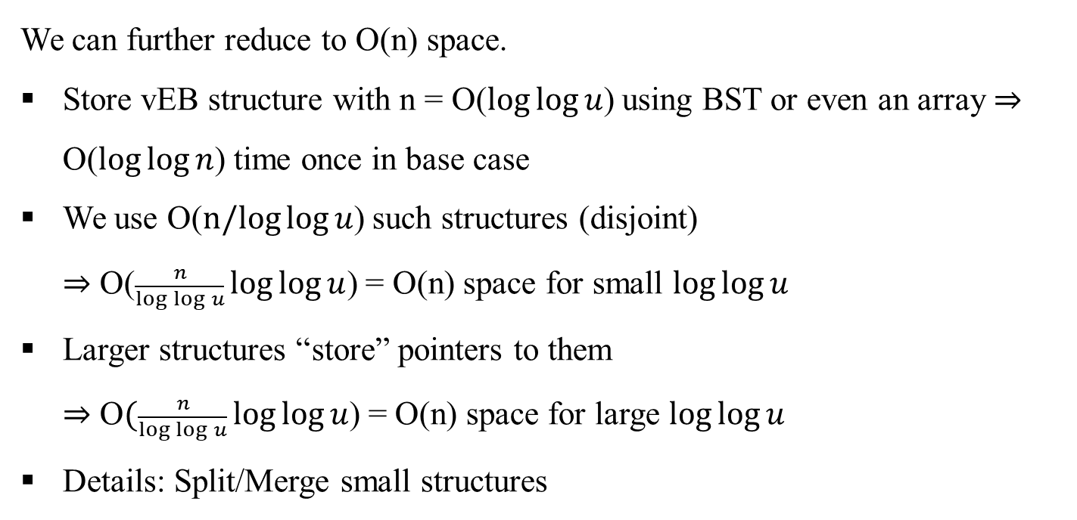
8. Indirection
We can further reduce to O(n) space.
Store vEB structure with n = O($\log{\log{u}}$) using BST or even an array ⇒ O($\log{\log{n}}$) time once in base case
We use O($n/log{\log{u}}$) such structures (disjoint)
⇒ O($\frac{n}{\log{\log{u}}}\log{\log{u}}$) = O(n) space for small $\log{\log{u}}$
Larger structures “store” pointers to them
⇒ O$(\frac{n}{\log{\log{u}}}\log{\log{u}}$) = O(n) space for large $\log{\log{u}}$
Details: Split/Merge small structures

